Slide 1

Advanced Machine Learning
ICT-
By-
Dr. Jesmin Akhter
Professor
Institute of Information Technology
Jahangirnagar University

Slide 2
Contents
The course will mainly cover the following topics:
Ensemble Learning
Unsupervised Learning
Clustering Fundamentals
Hierarchical Clustering
………………………..
Neural Networks and Deep Learning
Notes:
More Supervised - Adaboost Gradient boosting Xgboost

Slide 3
Outline
Types of machine learning

Slide 4
Types of machine learning
There are four major categories:
Supervised Machine Learning:
The training data you feed to the algorithm includes the desired solutions, called labels.
A typical supervised learning task is classification.
The spam filter is a good example. It is trained with many example emails along with their class (spam or not spam), and it must learn how to classify new emails.
Unsupervised Machine Learning:
The training data is unlabeled.
Anomaly detection—detecting unusual credit card transactions to prevent fraud, catching manufacturing defects, or automatically removing outliers from a dataset before feeding it to another learning algorithm.
The system is shown mostly normal instances during training, so it learns to recognize them and when it sees a new instance it can tell whether it looks like a normal one or whether it is likely an anomaly.
Notes:
Since learning involves an interaction between the learner and the environment, one can divide learning tasks according to the nature of that interaction.
Modern imaging techniques – X-rays, ultrasound, CT scans and MRI
A grocery store evaluating customer purchase data to discover which goods are usually purchased together is a real-world example of market basket analysis. Customers who buy bread may also buy peanut butter, jelly, and bananas, according to the study
Some Examples of Text Classification:
Sentiment Analysis.
Language Detection.
Fraud Profanity & Online Abuse Detection.
Detecting Trends in Customer Feedback.
Urgency Detection in Customer Support.
Sentiment analysis (or opinion mining) is a natural language processing (NLP) technique used to determine whether data is positive, negative or neutral. Sentiment analysis is often performed on textual data to help businesses monitor brand and product sentiment in customer feedback, and understand customer needs.
Reinforcement learning (RL) is the new approach to teaching machines to interact with the environment and receive rewards for performing the right actions until they successfully meet their goal. Just as the human brain makes choices based on the good or bad effects of previous decisions, so does RL — but with greater speed, accuracy, and scale. RL is a step toward mimicking the true human intelligence where we learn from the success and/or failure of multiple outcomes and form a winning strategy of the future.
Self-driving cars are autonomous vehicles that can navigate roads and traffic without human intervention. To achieve this, they need to perceive the surrounding environment, plan the optimal route, and execute the appropriate actions. RL is a natural fit for this task, as it can enable self-driving cars to learn from their own experience and adapt to changing situations

Slide 5
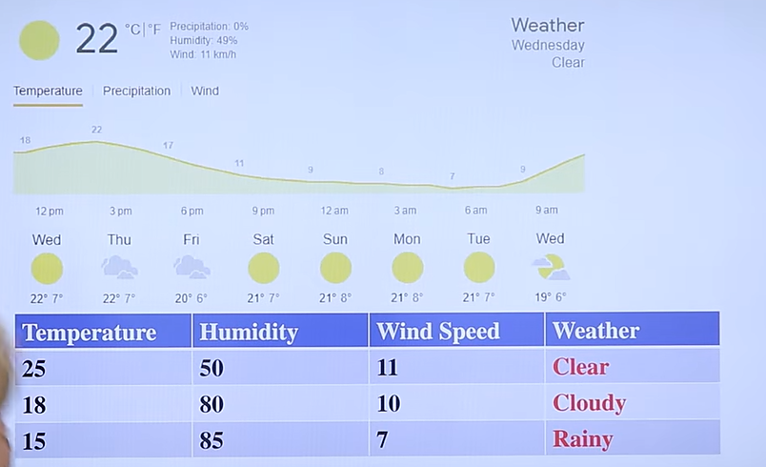
Supervised Machine Learning

Slide 6
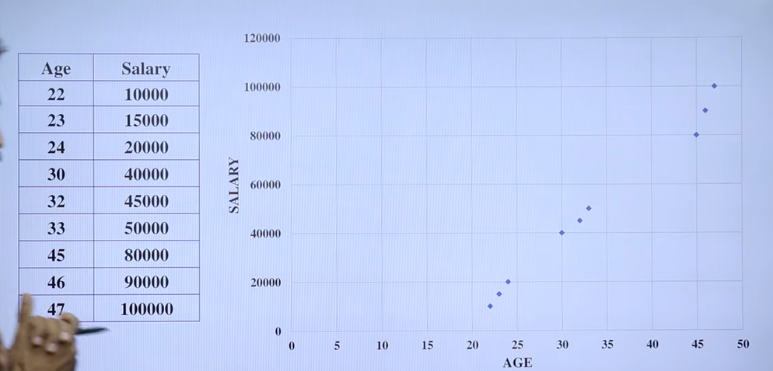
Unsupervised Machine Learning

Slide 7
Types of machine learning
Semi-Supervised Machine Learning:
Some algorithms can deal with partially labeled training data, usually a lot of unlabeled data and a little bit of labeled data. This is called semisupervised learning.
Example: Text Classification
Sentiment analysis (or opinion mining) is a natural language processing (NLP) technique used to determine whether data is positive, negative or neutral. Sentiment analysis is often performed on textual data to help businesses to monitor brand and product from the sentiment in customer feedback, and understand customer needs.
Web content classification-With SSL, Google Search finds content that is most relevant to a particular user query.
Notes:
Facebook (Meta) has successfully applied semi-supervised learning (self-training method) to its speech recognition models and improved them.

Slide 8
Types of machine learning
Reinforcement Learning:
The learning system, called an agent in this context, can observe the environment, select and perform actions, and get rewards in return or penalties in the form of negative rewards. It must then learn by itself what is the best strategy, called a policy, to get the most reward over time.
Self-driving cars to learn from their own experience and adapt to changing situations. Self-driving cars are autonomous vehicles that can navigate roads and traffic without human intervention. To achieve this, they need to perceive the surrounding environment, plan the optimal route, and execute the appropriate actions. RL is a natural fit for this task, as it can enable self-driving cars to learn from their own experience and adapt to changing situations
Notes:
A policy defines what action the agent should choose when it is in a given situation. For example, many robots implement Reinforcement Learning algorithms to learn how to walk.
Modern imaging techniques – X-rays, ultrasound, CT scans and MRI
A grocery store evaluating customer purchase data to discover which goods are usually purchased together is a real-world example of market basket analysis. Customers who buy bread may also buy peanut butter, jelly, and bananas, according to the study
Some Examples of Text Classification:
Sentiment Analysis.
Language Detection.
Fraud Profanity & Online Abuse Detection.
Detecting Trends in Customer Feedback.
Urgency Detection in Customer Support.
Sentiment analysis (or opinion mining) is a natural language processing (NLP) technique used to determine whether data is positive, negative or neutral. Sentiment analysis is often performed on textual data to help businesses monitor brand and product sentiment in customer feedback, and understand customer needs.
Reinforcement learning (RL) is the new approach to teaching machines to interact with the environment and receive rewards for performing the right actions until they successfully meet their goal. Just as the human brain makes choices based on the good or bad effects of previous decisions, so does RL — but with greater speed, accuracy, and scale. RL is a step toward mimicking the true human intelligence where we learn from the success and/or failure of multiple outcomes and form a winning strategy of the future.

Slide 9
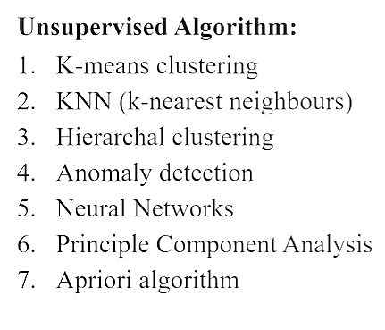
Types of Unsupervised Learning
Unsupervised learning can be broken down into three main tasks:
Clustering
Association rules
Dimensionality reduction.

Slide 10
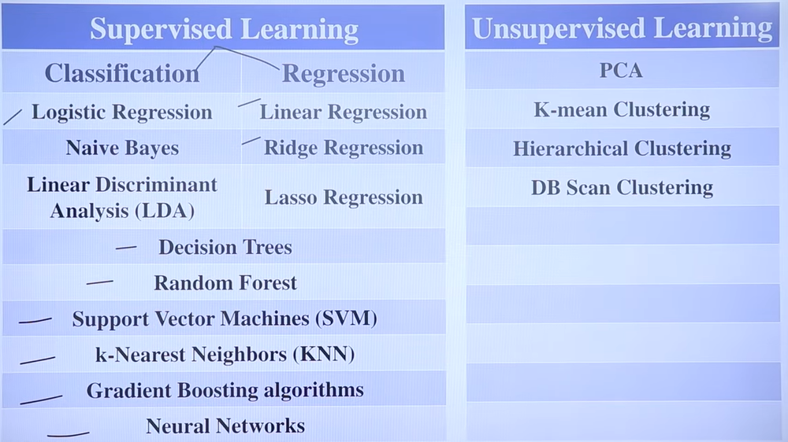

Slide 11
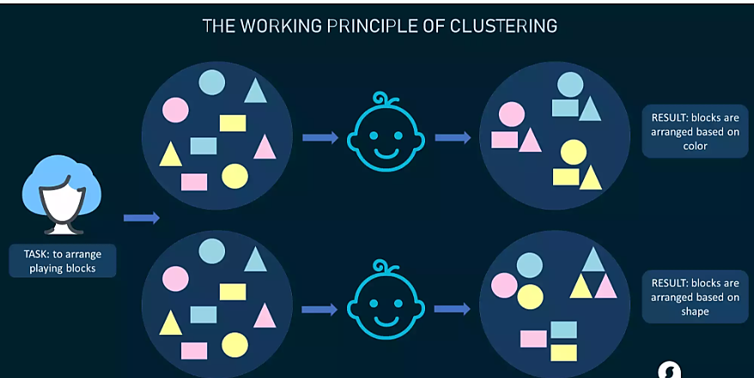
Types of Unsupervised Learning
Clustering Algorithms
Clustering algorithms only interpret the input data and find natural groups or clusters in feature space
Clustering is a popular type of unsupervised learning approach. You can even break it down further into different types of clustering; for example:
Exlcusive clustering: or “hard” clustering
It is the kind of grouping in which one piece of data can belong only to one cluster.
Overlapping clustering:
A soft cluster in which a single data point may belong to multiple clusters with varying degrees of membership.

Slide 12
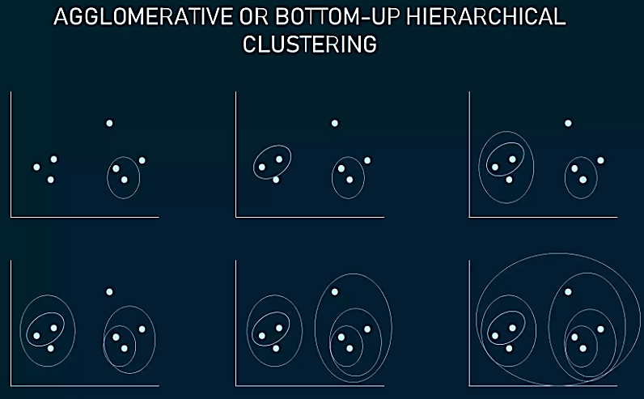
Types of Unsupervised Learning
Clustering Algorithms
Hierarchical Clustering:
Hierarchical clustering develops a hierarchy of clusters by merging or splitting them depending on their similarity. Here, two close cluster are going to be in the same cluster.
In case you start with all data items attached to the same cluster and then perform splits until each data item is set as a separate cluster, the approach will be called top-down or divisive hierarchical clustering.
Two clusters that are closest to one another are then merged into a single cluster. The merging goes on iteratively till there's only one cluster left at the top. Such an approach is known as bottom-up or agglomerative.
The example shows how seven different clusters (data points) are merged step by step based on distance until they all create one large cluster.

Slide 13
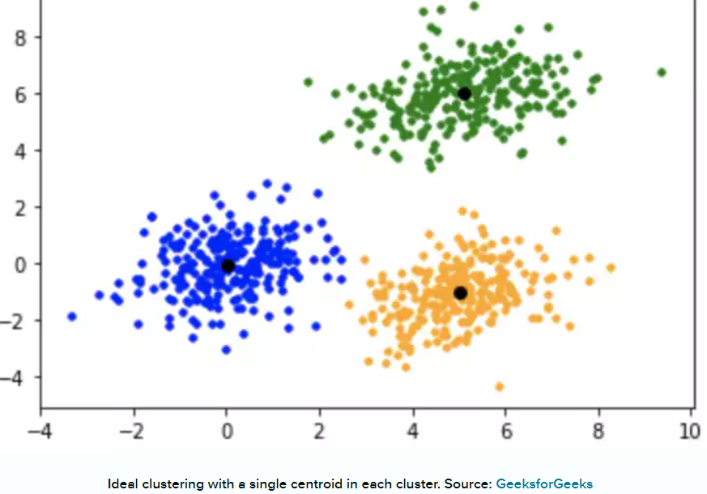
Types of Unsupervised Learning
Clustering Algorithms
K-Means Clustering
In K-means clustering, data is grouped in terms of characteristics and similarities.
K is a letter that represents the number of clusters. For example, if K=3, then the number of desired clusters is 3. If K=10, then the number of desired clusters is 10.
It puts the data points into the predefined number of clusters K.
Each data item then gets assigned to the nearest cluster center, called centroids (black dots in the picture). The later act as data accumulation areas.
The procedure of clustering may be repeated several times until the clusters are well-defined.
Notes:
In this algorithm, data is divided into a specific number of groups or clusters. It is achieved by minimizing the total squared distances between the data points and the centers of each cluster.

Slide 14
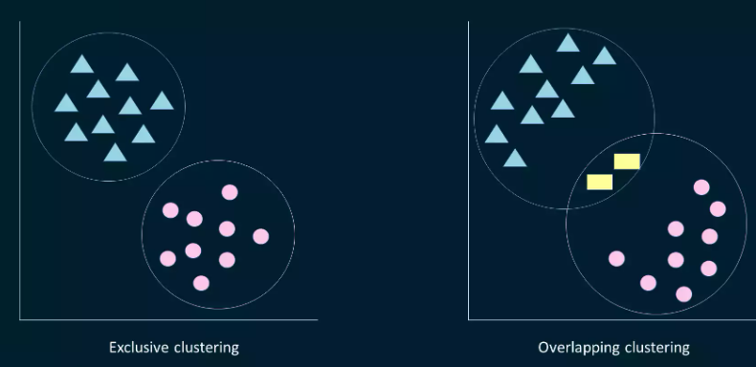
Types of Unsupervised Learning
Clustering Algorithms
Fuzzy K-means
It is an extension of the K-means algorithm used to perform overlapping clustering. Unlike the K-means algorithm, fuzzy K-means implies that data points can belong to more than one cluster with a certain level of closeness towards each.
The closeness is measured by the distance from a data point to the centroid of the cluster. So, sometimes there may be an overlap between different clusters.

Slide 15
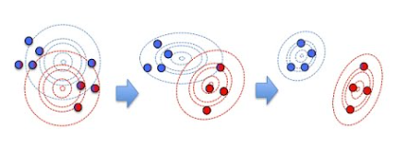
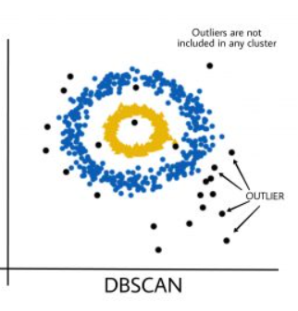
Types of Unsupervised Learning
Clustering Algorithms
Gaussian Mixture Models (GMMs) is an algorithm used in probabilistic clustering.
Models assume that there is a certain number of Gaussian distributions, each representing a separate cluster.
The algorithm is basically utilized to decide which cluster a particular data point belongs to.
DBSCAN (Density-Based Spatial Clustering of Applications with Noise): DBSCAN groups data points based on their density, identifying clusters of high-density regions and classifying outliers as noise.

Slide 16
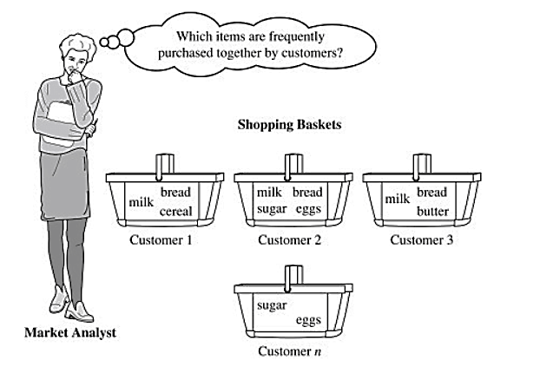
Types of Unsupervised Learning
Association Rule Mining
Association rule mining focuses on discovering interesting relationships or patterns between variables in the large database. It determines the set of items that occurs together in the dataset.
Association rule makes marketing strategy more effective. Such as people who buy X (suppose a bread) also tend purchase Y (Butter/Jam) item. The widely used algorithm for association rule mining is the Apriori algorithm.
A real-life example of this is market basket analysis, where retailers analyze customer purchase data to identify relationships between products frequently bought together. For instance, this analysis might reveal that customers who purchase diapers also tend to buy baby wipes

Slide 17
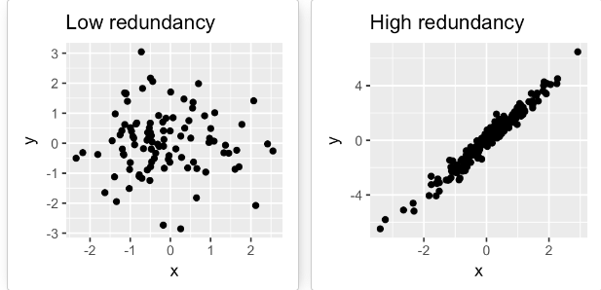
Types of Unsupervised Learning
Dimensionality Reduction Algorithms Dimensionality reduction techniques are used to reduce the number of input variables or features while retaining meaningful information. Some popular dimensionality reduction algorithms include:
Principal Component Analysis (PCA): PCA transforms the original features into a lower-dimensional space while preserving the maximum amount of information.
The PCA method is particularly useful when the variables within the data set are highly correlated. Correlation indicates that there is redundancy in the data. Due to this redundancy, PCA can be used to reduce the original variables into a smaller number of new variables ( principal components) explaining most of the variance in the original variables.

Slide 18
What is the difference between supervised and unsupervised learning?
Supervised learning requires labeled data with input features and corresponding output labels, while unsupervised learning aims to discover patterns or structures in unlabeled data without predefined output labels.

Slide 19

Reinforcement machine learning
Reinforcement Learning(RL) enables an agent to learn in an interactive environment by trial and error using feedback from its own actions and experiences.
Here, agents are self-trained on reward and punishment mechanisms.
It can take actions and interact with it.
Reinforcement machine learning algorithm isn’t trained using sample data.
It learns via interaction and feedback.
A sequence of successful outcomes will be reinforced to develop the best recommendation or policy for a given problem.
Basic Diagram of Reinforcement Learning
Notes:
This model learns as it goes by using trial and error.

Slide 20
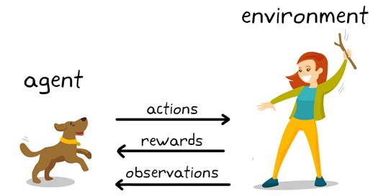
Reinforcement learning Example
You can see a dog and a master. Let’s imagine you are training your dog to get the stick. Each time the dog gets a stick successfully, you offered him a feast (a bone ).
Eventually, the dog understands the pattern, that whenever the master throws a stick, it should get it as early as it can gain a reward (a bone) from a master in a lesser time.

Slide 21
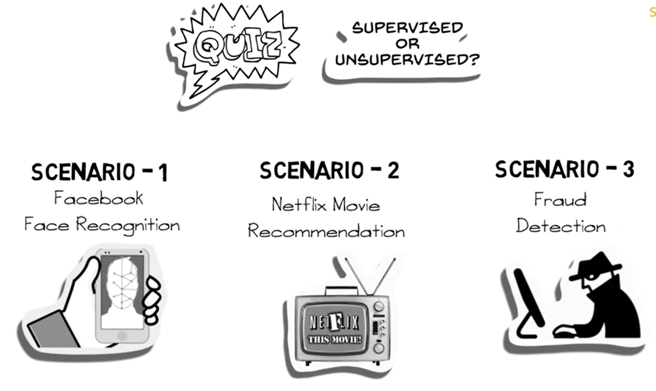

Slide 22
Explanation
Scenario 1: Facebook recognizes your friend in a picture from an album of tagged photographs
Explanation: It is supervised learning. Here Facebook is using tagged photos to recognize the person. Therefore, the tagged photos become the labels of the pictures and we know that when the machine is learning from labeled data, it is supervised learning.
Scenario 2: Recommending new songs based on someone’s past music choices
Explanation: It is supervised learning. The model is training a classifier on pre-existing labels (genres of songs). This is what Netflix, Pandora, and Spotify do all the time, they collect the songs/movies that you like already, evaluate the features based on your likes/dislikes and then recommend new movies/songs based on similar features.
Scenario 3: Analyze bank data for suspicious looking transactions and flag the fraud transactions
Explanation: It is unsupervised learning. In this case, the suspicious transactions are not defined, hence there are no labels of "fraud" and "not fraud". The model tries to identify outliers by looking at anomalous transactions and flags them as 'fraud'.

Slide 23
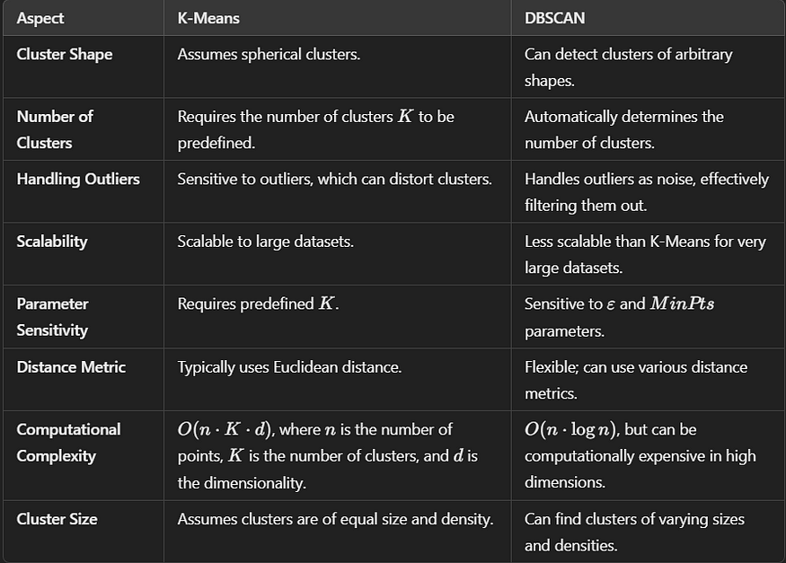

Slide 24
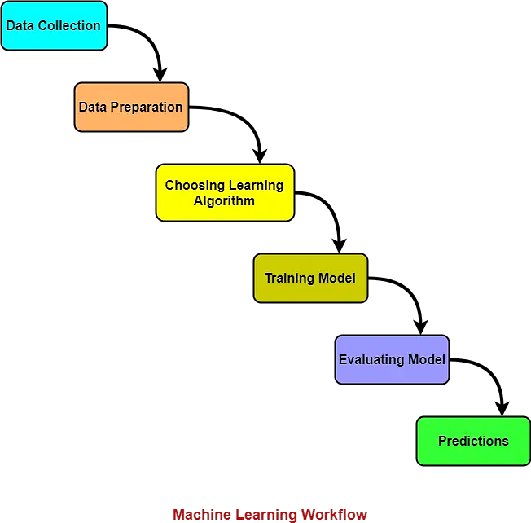
Machine Learning Workflow
Machine learning workflow refers to the series of stages or steps involved in the process of building a successful machine learning system.
The various stages involved in the machine learning workflow are-
Data Collection
Data Preparation
Choosing Learning Algorithm
Training Model
Evaluating Model
Predictions

Slide 25
1. Data Collection-
Data is collected from different sources.
The type of data collected depends upon the type of desired project.
Data may be collected from various sources such as files, databases etc.
The quality and quantity of gathered data directly affects the accuracy of the desired system.
2. Data Preparation-
Data preparation is done to clean the raw data.
Data collected from the real world is transformed to a clean dataset.
Raw data may contain missing values, inconsistent values, duplicate instances etc.
So, raw data cannot be directly used for building a model.
Different methods of cleaning the dataset are-
Ignoring the missing values
Removing instances having missing values from the dataset.
Estimating the missing values of instances using mean, median or mode.
Removing duplicate instances from the dataset.
Normalizing the data in the dataset.
This is the most time consuming stage in machine learning workflow.

Slide 26
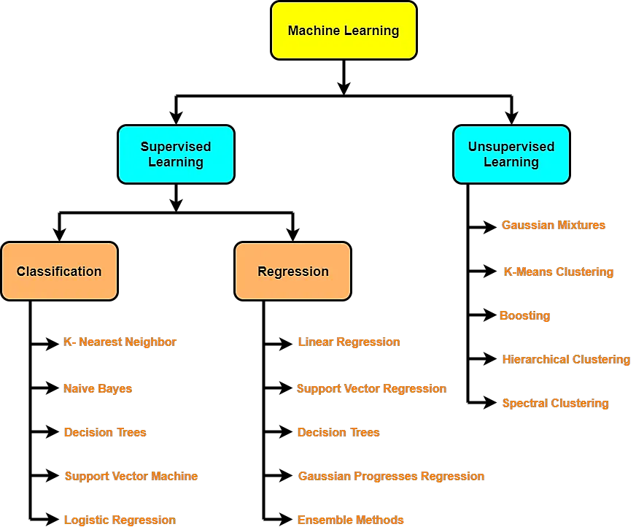
3. Choosing Learning Algorithm-
The best performing learning algorithm is researched.
It depends upon the type of problem that needs to be solved and the type of data we have.
If the problem is to classify and the data is labeled, classification algorithms are used.
If the problem is to perform a regression task and the data is labeled, regression algorithms are used.
If the problem is to create clusters and the data is unlabeled, clustering algorithms are used.
The following chart provides the overview of learning algorithms-

Slide 27

4. Training Model-
The model is trained to improve its ability.
The dataset is divided into training dataset and testing dataset.
The training and testing split is order of 80/20 or 70/30.
It also depends upon the size of the dataset.
Training dataset is used for training purpose.
Testing dataset is used for the testing purpose.
Training dataset is fed to the learning algorithm.
The learning algorithm finds a mapping between the input and the output and generates the model.

Slide 28
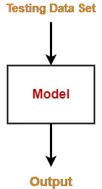
5. Evaluating Model-
The model is evaluated to test if the model is good.
The model is evaluated using the kept-aside testing dataset.
It allows to test the model against data that has never been used before for training.
Metrics such as accuracy, precision, recall etc are used to test the performance.
If the model does not perform well, the model is re-built using different hyper parameters.
The accuracy may be further improved by tuning the hyper parameters.

Slide 29
6. Predictions-
The built system is finally used to do something useful in the real world.
Here, the true value of machine learning is realized.

Slide 30
Thank You

